Slide 1
DENSITY ESTIMATION
PARZEN WINDOW
K-NEAREST-NEIGHBOR ESTIMATION

Slide 2
Nonparametric Methods
In parametric methods, whether for density estimation, classification, or regression, we assume a model valid over the whole input space.
In regression, for example, when we assume a linear model, we assume that for any input, the output is the same linear function of the input.
In classification when we assume a normal density, we assume that all examples of the class are drawn from this same density.
The advantage of a parametric method is that it reduces the problem of estimating a probability density function, discriminant, or regression function to estimating the values of a small number of parameters.
Its disadvantage is that this assumption does not always hold and we may incur a large error if it does not.

Slide 3
If we cannot make such assumptions and cannot come up with a parametric model.
In nonparametric estimation, all we assume is that similar inputs have similar outputs.
This is a reasonable assumption: the world is smooth and functions, whether they are densities, discriminants, or regression functions, change slowly.
Similar instances mean similar things.
We all love our neighbors because they are so much like us.
Therefore, our algorithm is composed of finding the similar past instances from the training set using a suitable distance measure and interpolating from them to find the right output.

Slide 4
Different nonparametric methods differ in the way they define similarity or interpolate from the similar training instances.
In a parametric model, all of the training instances affect the final global estimate.
Whereas in the nonparametric case, there is no single global model;
Local models are estimated as they are needed, affected only by the nearby training instances.
Nonparametric methods do not assume any a priori parametric form for the underlying densities;
A nonparametric model is not fixed but its complexity depends on the size of the training set, or rather, the complexity of the problem inherent in the data.

Slide 5
In machine learning literature, nonparametric methods are also called instance-based or instance-based memory-based learning algorithms.
Such methods are also called lazy learning algorithms, because unlike the eager parametric models.
They do not compute a model when they are given the training set but postpone the computation of the model until they are given a test instance.

Slide 6
Nonparametric Density Estimation
As usual in density estimation, we assume that the sampleX ={xt}Nt=1 is drawn independently from some unknown probability density p(·).
ˆp(·) is our estimator of p(·).
The nonparametric estimator for the cumulative distribution function, F(x), at point x is the proportion of sample points that are less than or equal to x.
F(x) = #{xt ≤ x}/N
where #{xt ≤ x} denotes the number of training instances whose xt is less than or equal to x.

Slide 7

Similarly, the nonparametric estimate for the density function can be calculated as.
Where h is the length of the interval and instances xt that fall in this interval are assumed to be “close enough.”
Different types of nonparametric estimation methods are:-
  Histogram estimation
  Naive estimation
  Kernel Estimation

Slide 8

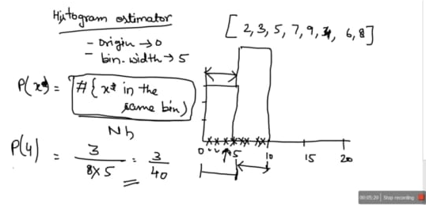
Histogram Estimator

Slide 9
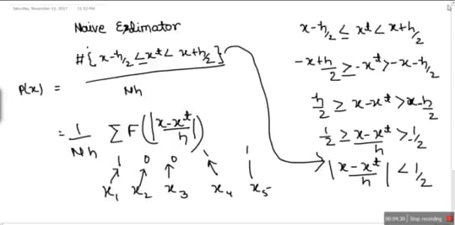
Naive Estimator

Slide 10
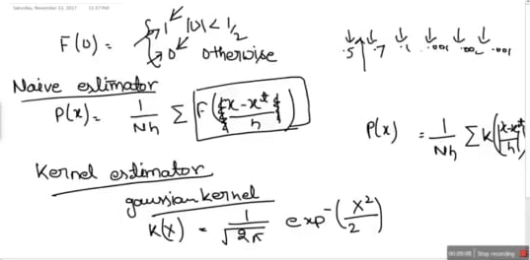
Kernel Estimator

Slide 11
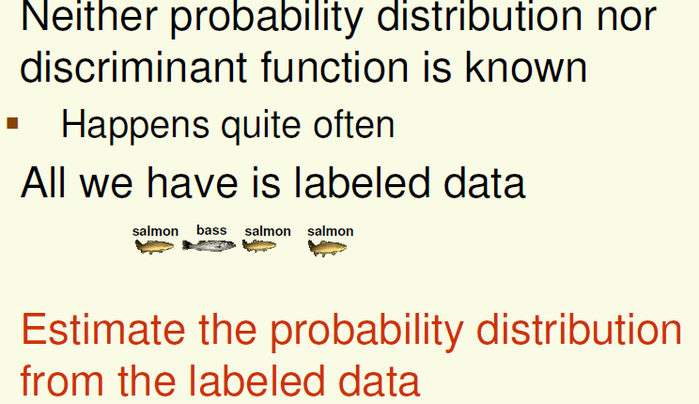
Non-Parametric Techniques
All Parametric densities are unimodal (have a single local maximum), whereas many practical problems involve multi-modal densities.
Nonparametric procedures can be used with arbitrary distributions and without the assumption that the forms of the underlying densities are known

Slide 12
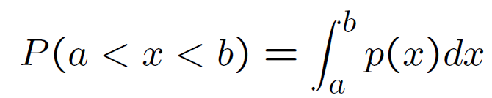
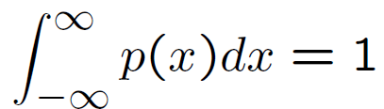
Probability density function (pdf)
The mathematical definition of a continuous probability function, p(x), satisfies the following properties:
  The probability that x is between two points a and b.
  It is non-negative for all real x.
  The integral of the probability function is one, that is

Slide 13
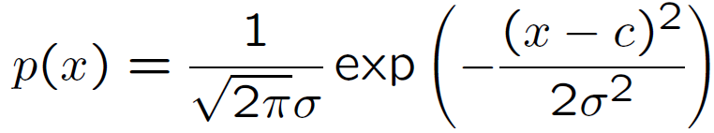
The most commonly used probability function is Gaussian function (also known as Normal distribution).
where c is the mean, ² is the variance and is the standard deviation.

Slide 14
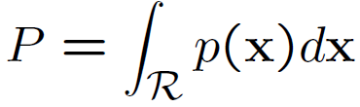
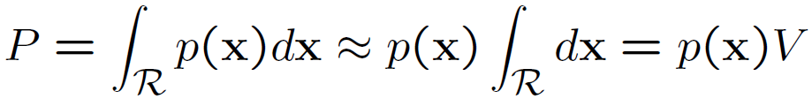
Density estimation
Given a set of n data samples x1,..., xn, we can estimate the density function p(x), so that we can output p(x) for any new sample x. This is called density estimation.
The basic ideas behind many of the methods of estimating an unknown probability density function are very simple. The most fundamental techniques rely on the fact that the probability P that a vector falls in a region R is given by
If we now assume that R is so small that p(x) does not vary much within it, we can write
where V is the “volume” of R.

Slide 15

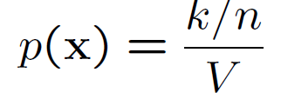
On the other hand, suppose that n samples x1,..., xn are independently drawn according to the probability density function p(x), and there are k out of n samples falling within the region R, we have
Thus we arrive at the following obvious estimate for p(x),

Slide 16
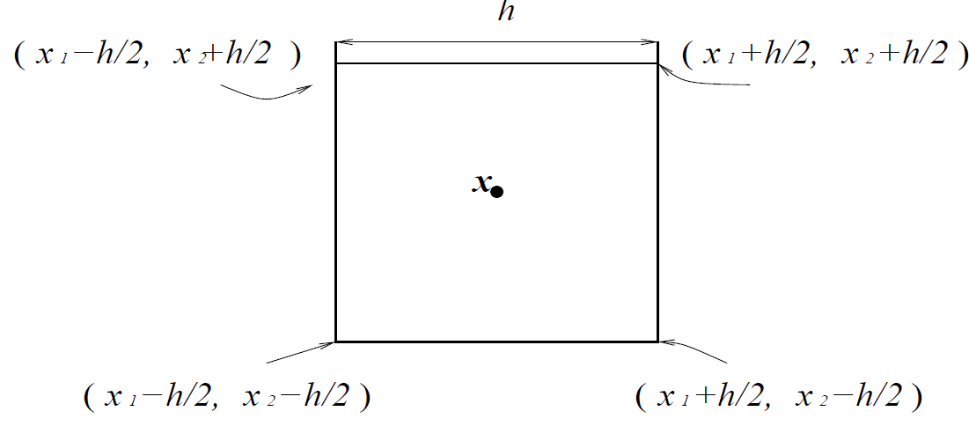
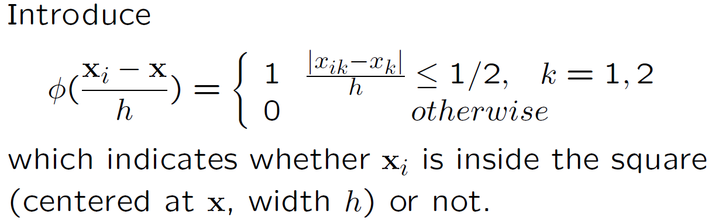
Parzen window density estimation
Consider that R is a hypercube centered at x (think about a 2-D square). Let h be the length of the edge of the hypercube, then V = h² for a 2-D square, and V = h³ for a 3-D cube.

Slide 17
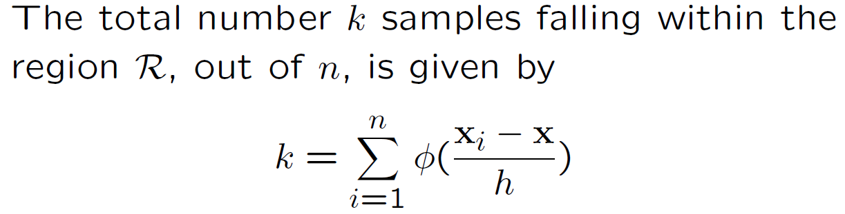
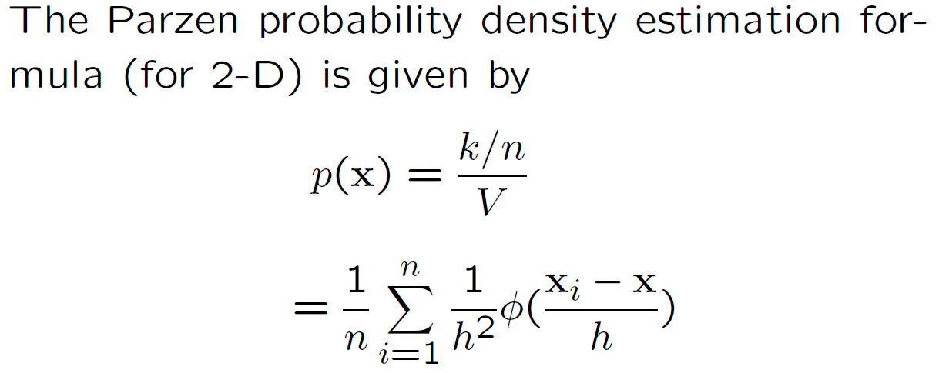

Slide 18

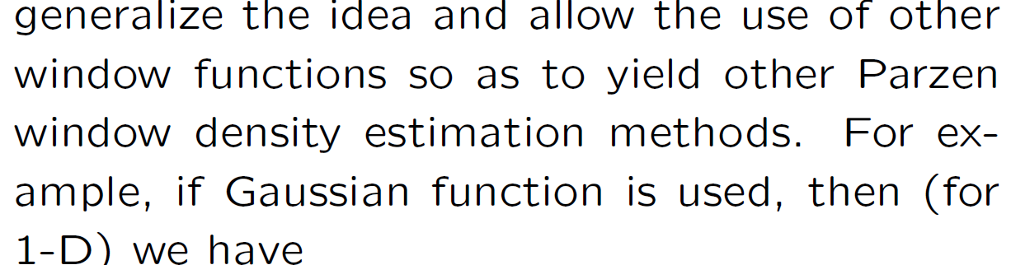
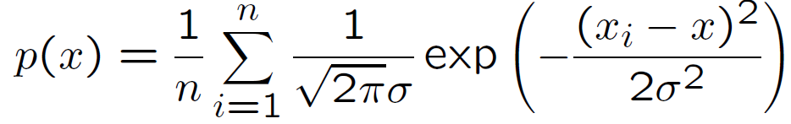
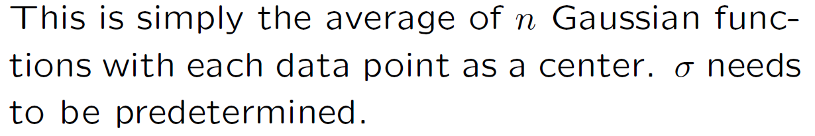

Slide 19

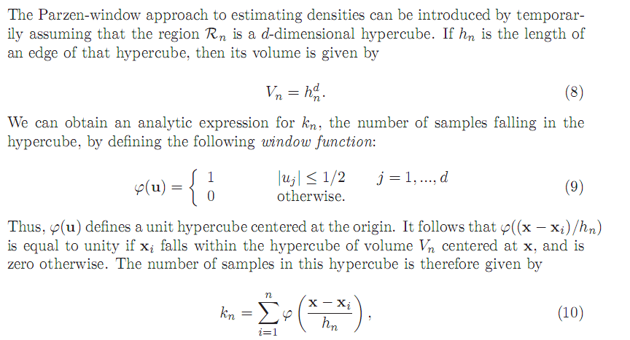


Slide 20
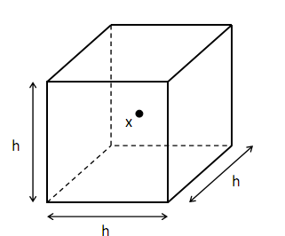
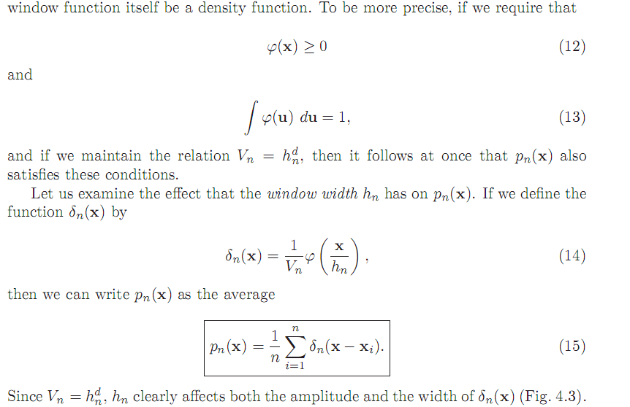

Slide 21
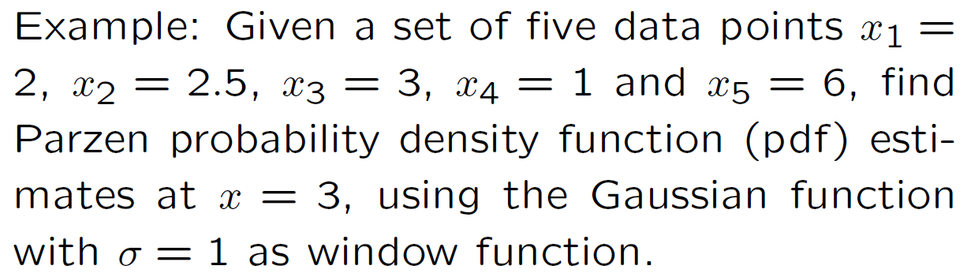
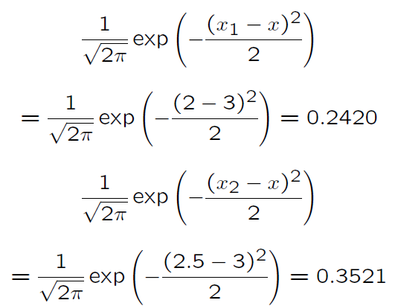
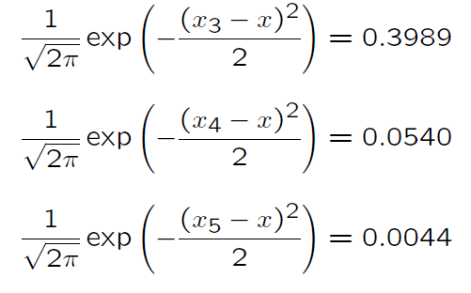


Slide 22
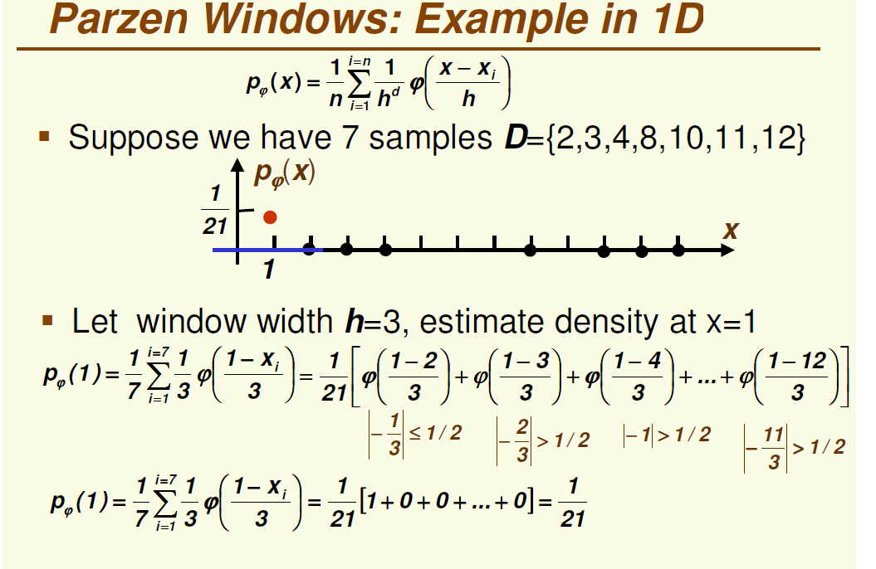

Slide 23
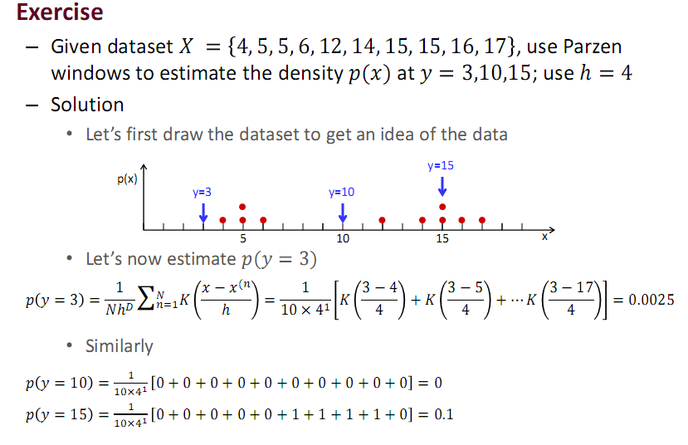

Slide 24
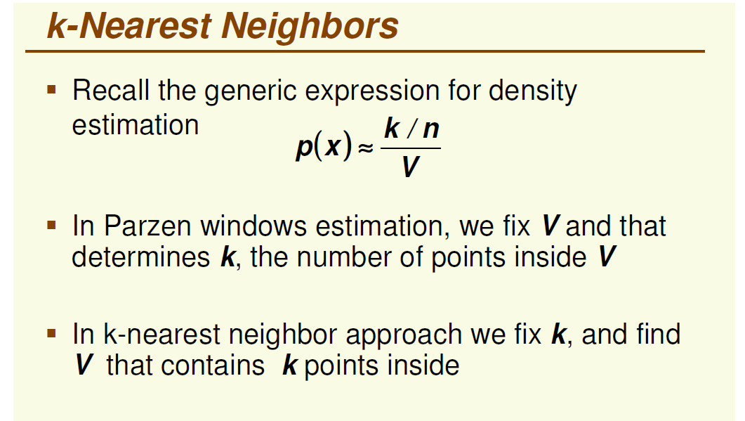

Slide 25
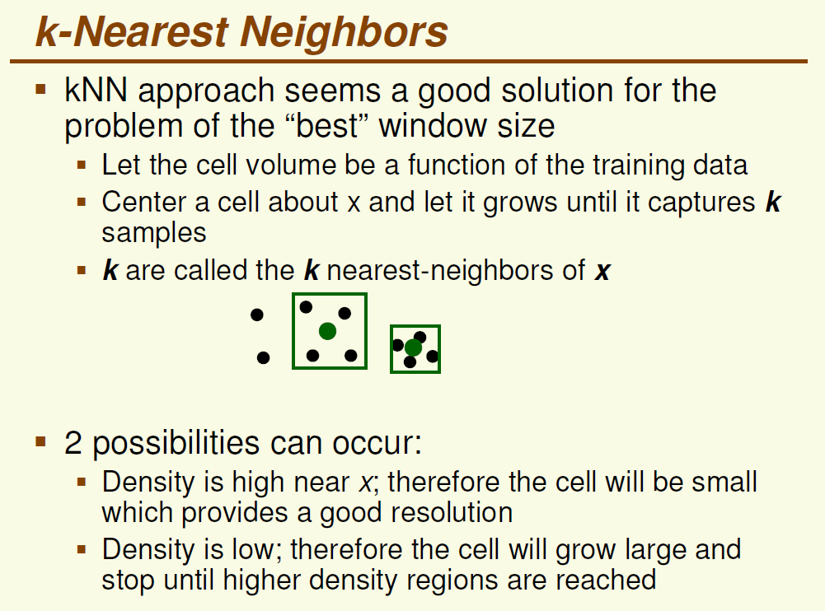

Slide 26
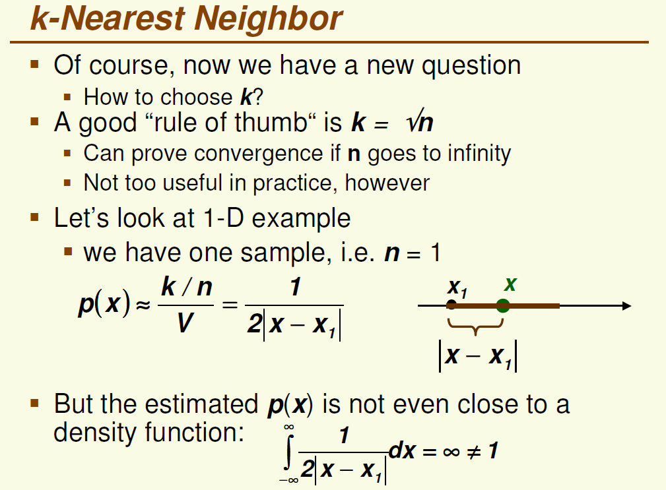

Slide 27
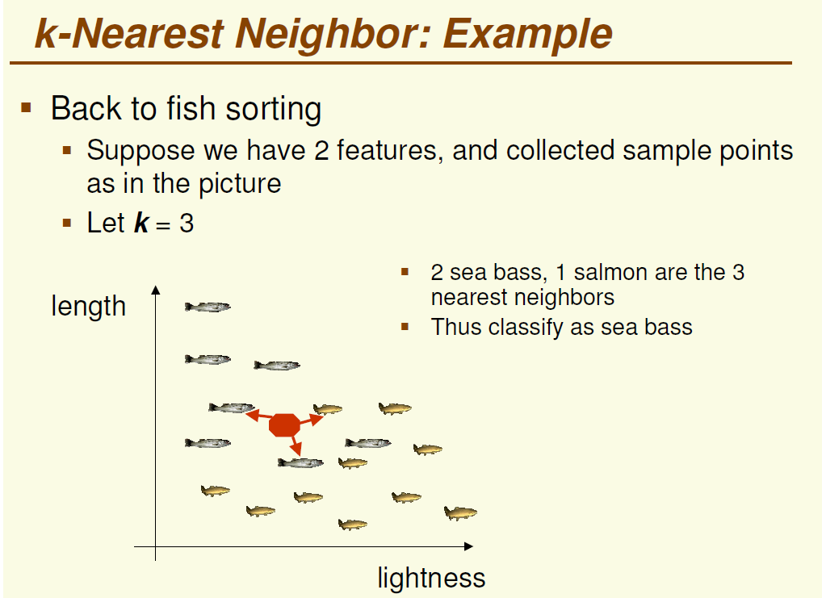

Slide 28
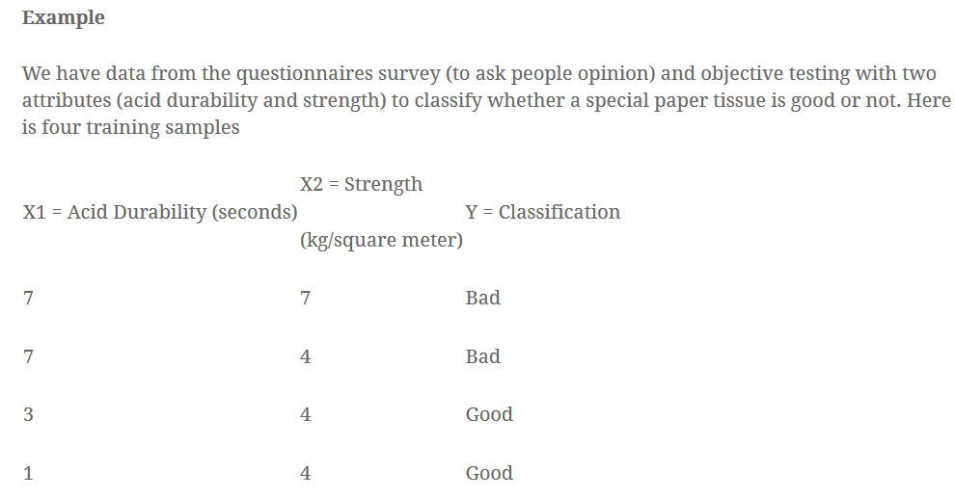
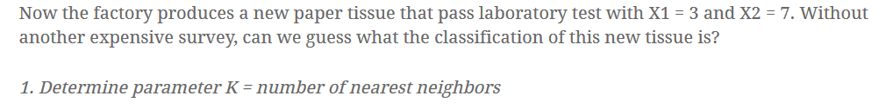

Slide 29
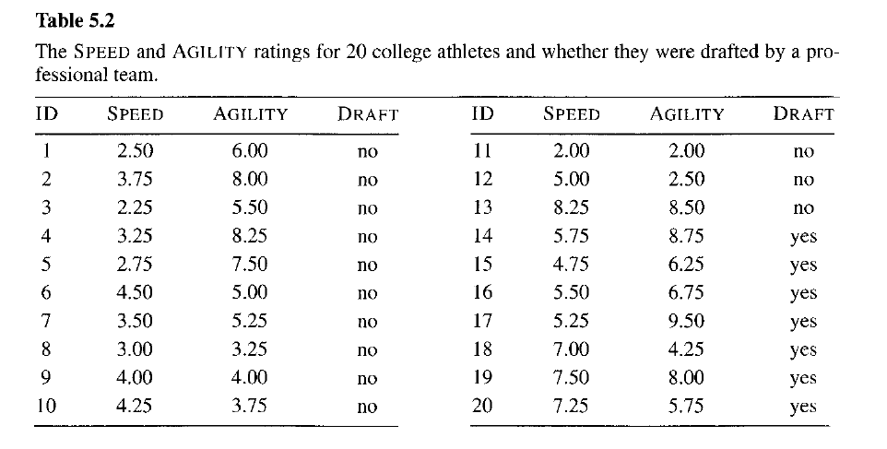
Exercise
Consider K= 4, Determine Draft

Slide 30
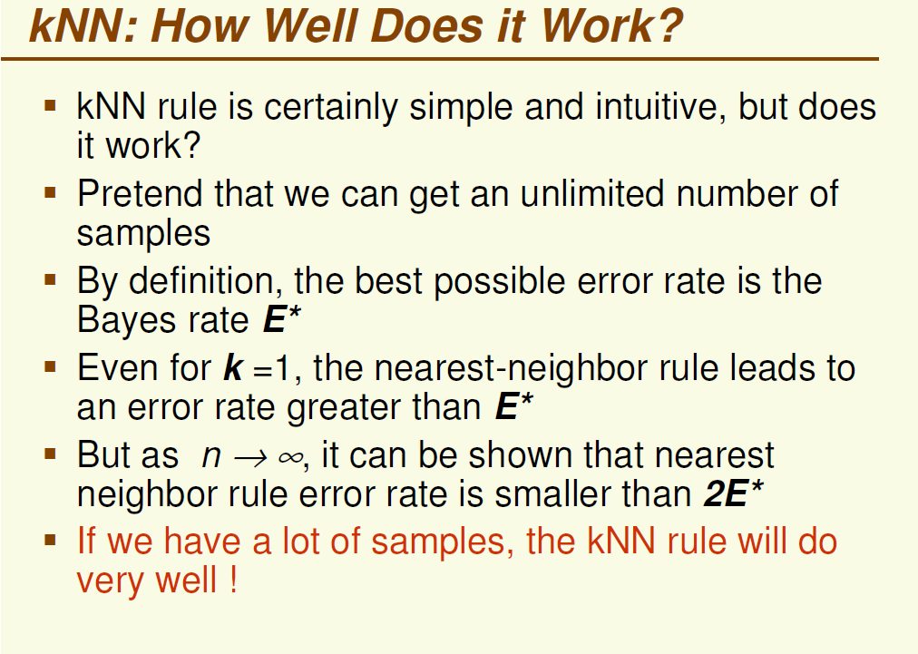

Slide 31
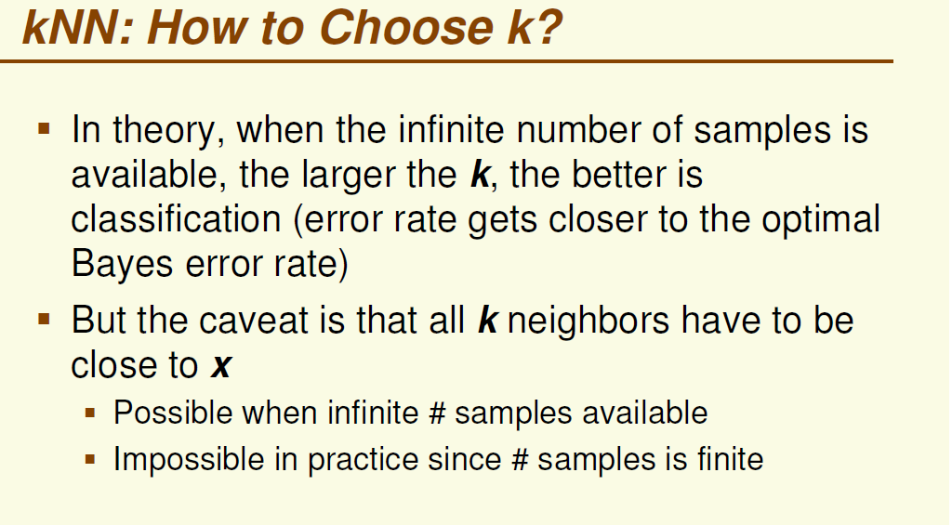

Slide 32
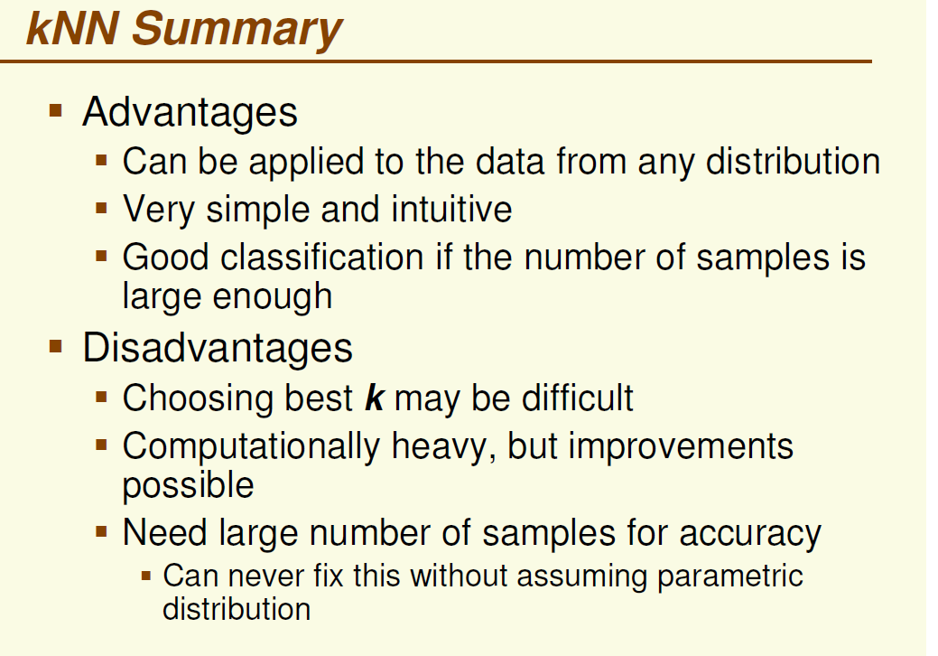

Slide 33


